Slide 1

MED-BUL PROJECT
Rotary Club Sofia International
District 2482 (Bulgaria)

Slide 2


Joint project of Rotary Club Sofia International, Rotary Club Bansko-Razlog and Rotary Club Rüsselsheim/Gross-Gerau from Germany
Project name: MED-Bul
Medical Equipment Donation for Bulgaria (MED-Bul)

Slide 3
Med-Bul
Intention:
RC Rüsselsheim/Gross-Gerau in cooperation with the RC Sofia International and Rotary Bansko-Razlog are organizing a donation of nearly new medical equipment (35 medical beds, anesthetic & endoscopy appliances) from German hospital Unfallklinik Murnau, Professor-Kuntscher-Strasse 8, 82418 Murnau am Staffelsee
Beneficiary - Kids hospital in Sofia, Dr. Blagomir Zdravkov.
RC Sofia International is trying to help organizing the transport in coordination with the RC Rüsselsheim/Gross-Gerau.

Slide 4
Med-Bul
Project Team:
RC Sofia International:
  Rumen Rusinov, Hristina Malchevska and Horst Stueer – coordination and transportation
  Svetozar Shkutov – legal advise
  All members support needed for finding sponsors

Slide 5
Med-Bul
Project Team:
RC Bansko-Razlog
  Dr. Sigrun Comati, project coordination between envolved Rotary Clubs
  Präsidentin der Deutsch-Bulgarischen Gesellschaft zur Förderung der Beziehungen zwischen Deutschland und Bulgarien e.V.
RC Rüsselsheim/Gross-Gerau :
  Wilfried Ehrlich, RC Foundation Coordinator, Project procurement and coordinator
    former Manufacturing Director Car Manufacturing Adam Opel AG Rüsselsheim
    Former Plant Director Componet Plant Kaiserslautern Adam Opel AG
    2002 till 2015 Managing Director BG Unfall Klinik Murnau

Slide 6
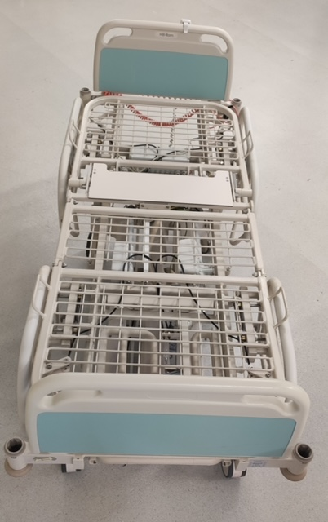
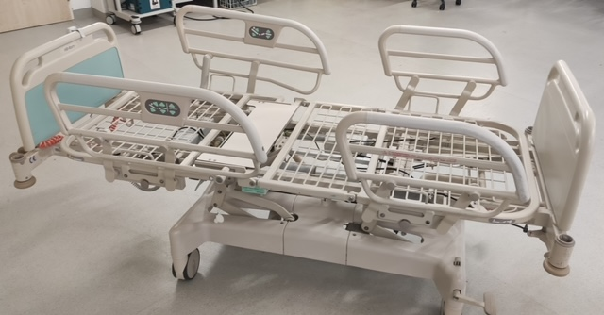
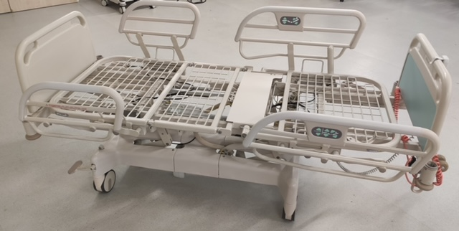
Med-Bul
Start of project: September 2021
Donation value - medical equipment current value for more than 46000 EUR
  35 clinic beds 800 € each = 28000 € current market value

Slide 7
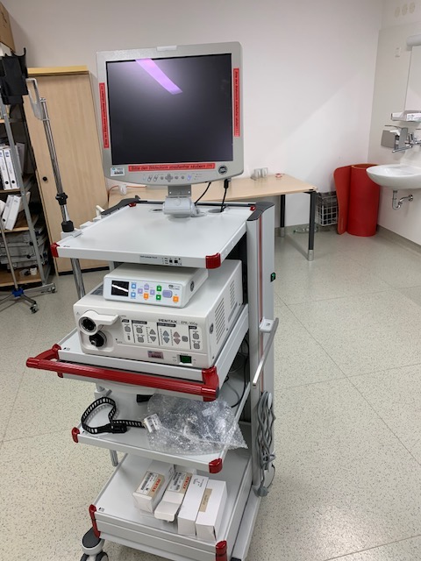
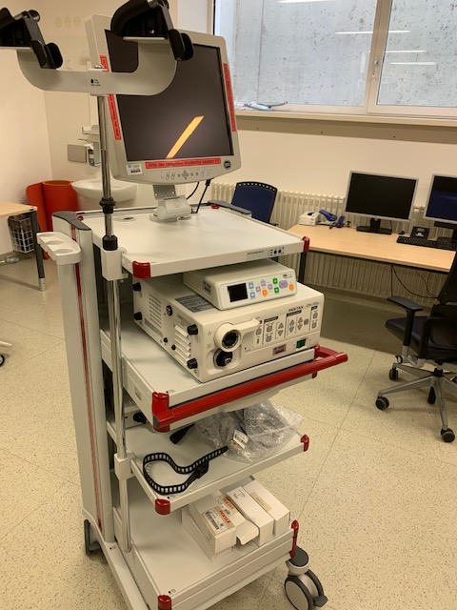
Med-Bul
Start of project: September 2021
Donation value - medical equipment current value for more than 46000 EUR
  35 clinic beds 800 € each = 28000 € market value
  4 anesthetic & 2 endoscopy towers average market value 3000 € each = 18000 €

Slide 8
Med-Bul
Start of project: September 2021
Donation value - medical equipment current value for more than 46000 EUR
  35 clinc beds 800 € each = 28000 € market value
  4 anesthetic & 2 endoscopy towers average market value 3000 € each = 18000 €
Two deliveries with two trucks to be organized till the beginning of November
- One truck with 35 medical beds
- Second truck with anesthetic/edoscopy appliances
Cost of transportation: 3720 EUR

Slide 9
Med-Bul
We need sponsors to help cover the transportation cost from the hospital in Germany to the Kid’s Hospital in Sofia in the amount of approx. 3000 EUR (need to define the cost of the second truck based on the sizes of part of the equipment)
Procurement, beneficiary & loading from the hospital in Germany will be supported by RC Rüsselsheim/Gross-Gerau and local unloading will be supported by RCSI and beneficiary hospital

Slide 10
A BIG Thank you
For contact and more details:
Hristina Malchevska
President, Rotary Club Sofia International
+359884964338; hbeeva@yahoo.com
Rotary Club Sofia International
District 2482 (Bulgaria)

